Slide 1
ZS - Machine Learning Challenge
By - Kumar Ritu Raj Singh

Slide 2
The problem
Statement
Metric
Given details of a construction/demolition site like its permit type, location, description, application status, work type etc, we need to identify if the task is related to one of the following building type:
Single Family / Duplex
Commercial
Institutional
Multifamily
Industrial
It is multiclass classification problem and is evaluated on the weighted average F1 score.

Slide 3
Section A
Approach, preprocessing, observations, model used and results.

Slide 4
The features we have
Permit Type - Categorical - 0% missing
Address - Key value pairs - 0.06% missing
Description - Textual - 0.04% missing
Action Type - Categorical - 2.25% missing
Work Type - Categorical - 0% missing
Applicant Name - Textual - 0.4% missing
Application Date - Date/Time - 20.45% missing
Issue Date - Date/Time - 31.42% missing
Final Date - Date/Time - 53.33% missing
Expiration Date - Date/Time - 31.27% missing

Slide 5
The features we have
Status - Categorical - 4.66% missing
Contractor - Categorical - 81.84% missing
Master Use Permit - Categorical - 86.57% missing
Latitude - Numeric - 0.07% missing
Longitude - Numeric - 0.07% missing

Slide 6
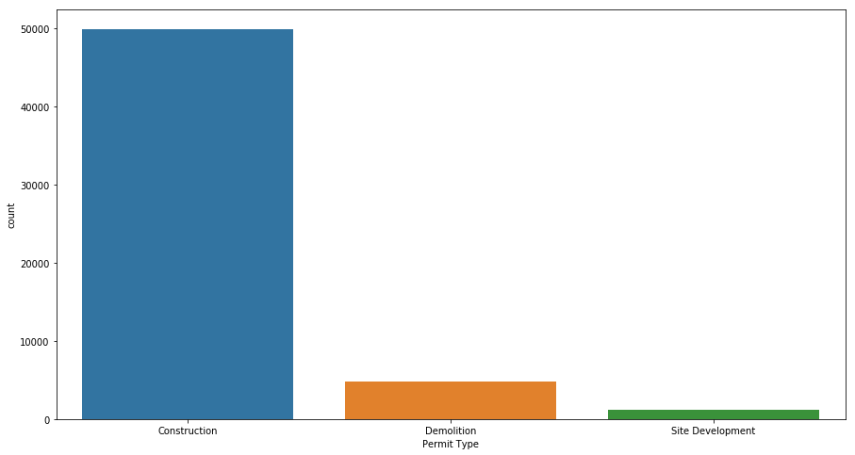
Processing - Permit Type
Categorical - 3
Types:
Construction
Demolition
Site Development
One-hot encoded this column
‘Construction’ is the most common permit type.

Slide 7
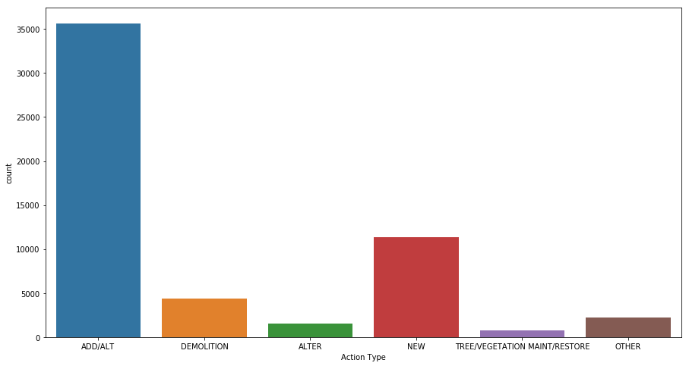
Processing - Action Type
Categorical - 16
Picked Top-5 most most popular action types and marked remaining as ‘Others’.
Types :
ADD/ALT
DEMOLITION
ALTER
NEW
TREE/VEGETATION MAINT/RESTORE
OTHER
One-hot encoded the resultant column.

Slide 8
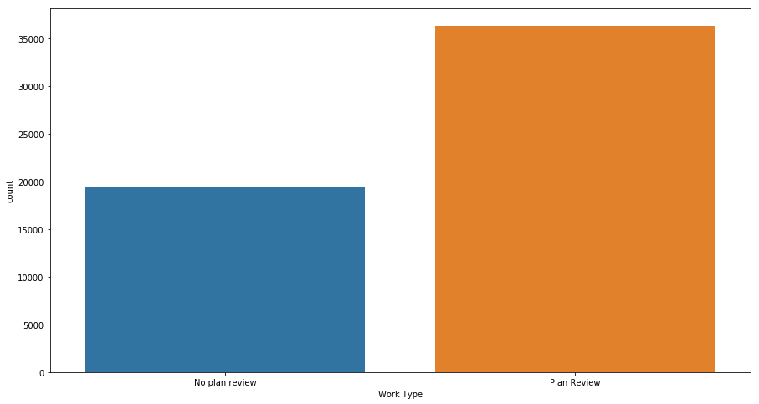
Processing - Work Type
Categorical - 2
Types:
Plan Review
No Plan Review
Marked ‘Plan Review’ as 1 and ‘No plan review’ as 0.

Slide 9
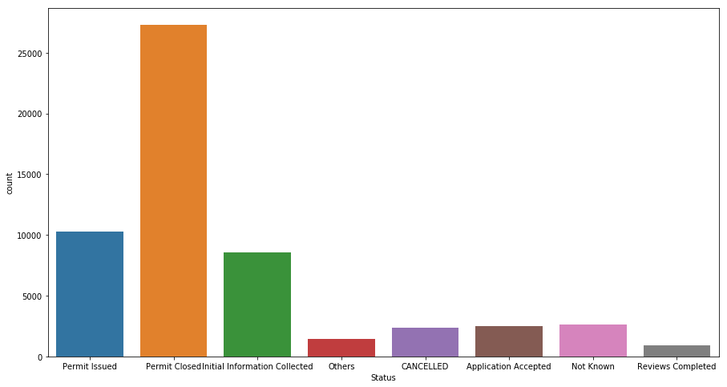
Processing - Status
Categorical - 12
Replaced missing values with ‘Not Known’.
Picked Top-7 most most popular ‘Status’ and marked remaining as ‘Others’.
One-hot encoded the resultant column.

Slide 10
Processing - Longitude and Latitude
Location of the site given in terms of latitude and longitude.
Mapped latitude and longitude to its respective position in 3D coordinate system.
Mappings :
X = cos(latitude) * cos(longitude)
Y = cos(latitude) * sin(longitude)
Z = sin(latitude)
Filled in missing values with -1

Slide 11
Processing - Address
Addresses are in the form : ‘9434 DELRIDGE WAY SW’
Separated the initial number in address with the remaining address.
Converted address number into a categorical column by keeping the address numbers with frequency > 100 and marking remaining as ‘Others’.
Converted remaining address into a categorical column by keeping the remaining address with frequency > 300 and marking remaining as ‘Others’.
One-hot encoded both of these resultant columns.

Slide 12
Processing - The Date Columns
Calculated number of days between:
Application date and Issue date
Issue date and Final date
Issue date and Expiration date
Replaced missing values with the mean of columns.
Standardized each of these three columns

Slide 13
Processing - Descriptions
Converted all words to lower-case.
Removed punctuation marks and other symbols.
Removed stopwords.
Stemmed the words.
Calculated TF-IDF values for to 500 relevant words in the description.

Slide 14
Other observations
Column of ‘Applicant's name’ was dropped because names were almost unique for each data point.
Column ‘Master Use Permit’ was dropped because it had very high missing values, and the remaining values were also unique.
In the end total 569 feature columns.
The X, Y and Z coordinates calculated by mapping latitude and longitude into 3D space, were the most relevant features (tf-idf values of words from ‘Description’ column was not taken into consideration).

Slide 15
Results
Decision Tree Classifier gave an weighted F1 score of 0.8234
Multi-Layer Perceptron gave an weighted F1 score of 0.8595
Random Forest Classifier gave an weighted F1 score of 0.8688
Gradient Boosting Classifier gave an weighted F1 score of 0.87765
eXtreme Gradient Boosting Classifier gave an weighted F1 score of 0.8758
All these scores are averaged over 2 cross validation runs.

Slide 16
Section B
Code Walk-Through

Slide 17
Thank You
Peak Performance

